Slide 1

predicting future outcomes
Tuna tuncay
Lse data analytics career accelerator
Spring 2022 cohort

Slide 2

Outline
Problem Definition
Analysis Focus Areas
Key Facts & Figures
Future Recommendations

Slide 3

PROBLEM DEFINITION
HOW TO INCREASE
OUR SALES?

Slide 4
ANALYSIS FOCUS AREAS
SALES ANALYSIS
SENTIMENT ANALYSIS
CUSTOMER SEGMENTS

Slide 5
KEY FACTS - WHO ARE OUR CUSTOMERS?
Customer Segment | Segment Size (%)
Average Earner & Average Spender | 38.7%
High Earner & High Spender | 17.8%
Low Earner & High Spender | 13.5%
High Earner & Low Spender | 16.5%
Low Earner & Low Spender | 13.5%
Grouped customers based on their earning and spending.
Largest customer group is average earner and spenders.
Each customer group have their most purchased products.

Slide 6

Key Facts - WHAT DO CUSTOMER THINK ABOUT OUR PRODUCTS?
Based on received reviews:

Slide 7
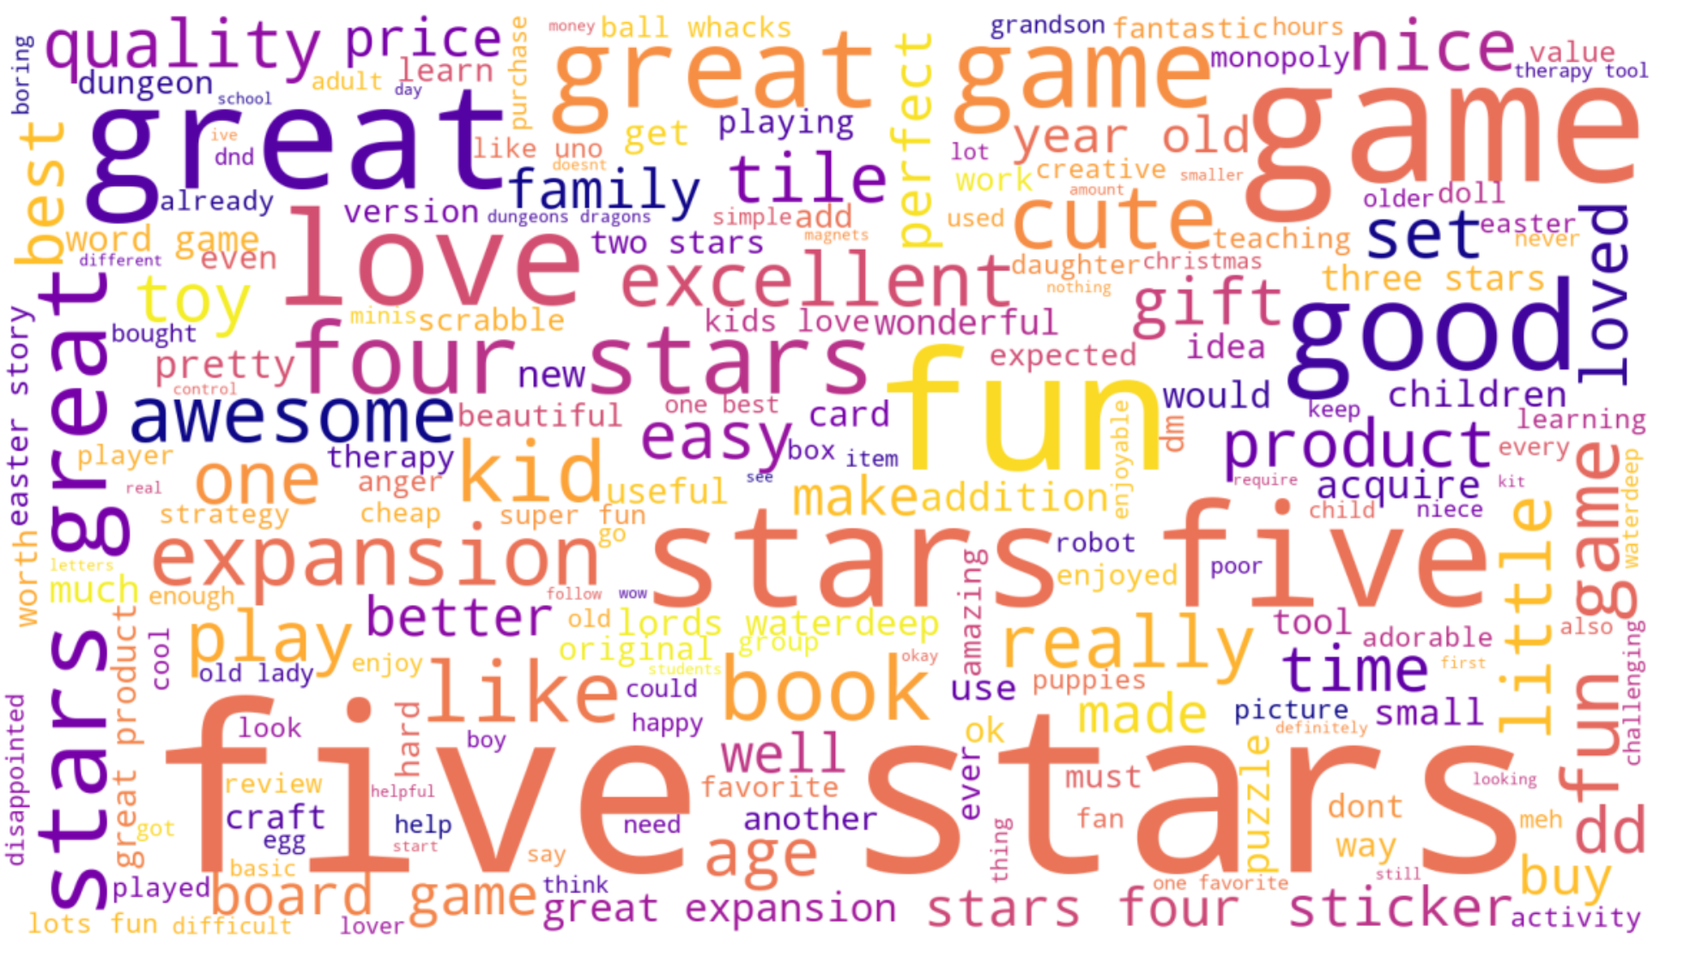
Key Facts - WHAT DO CUSTOMER THINK ABOUT OUR PRODUCTS?
Based on received summary:

Slide 8
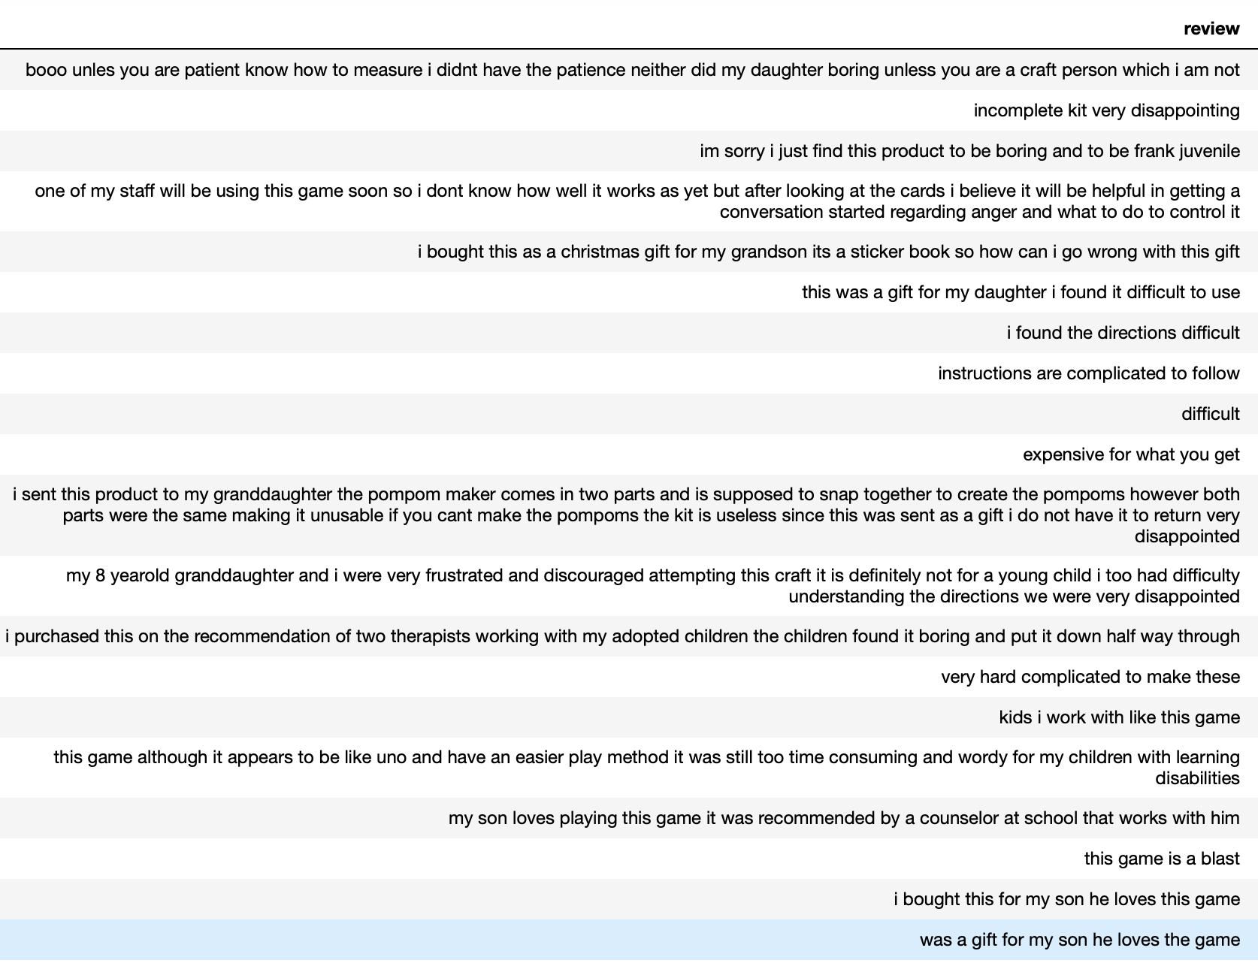
Key Facts - WHAT DO CUSTOMER THINK ABOUT OUR PRODUCTS?
Any bad comments?

Slide 9
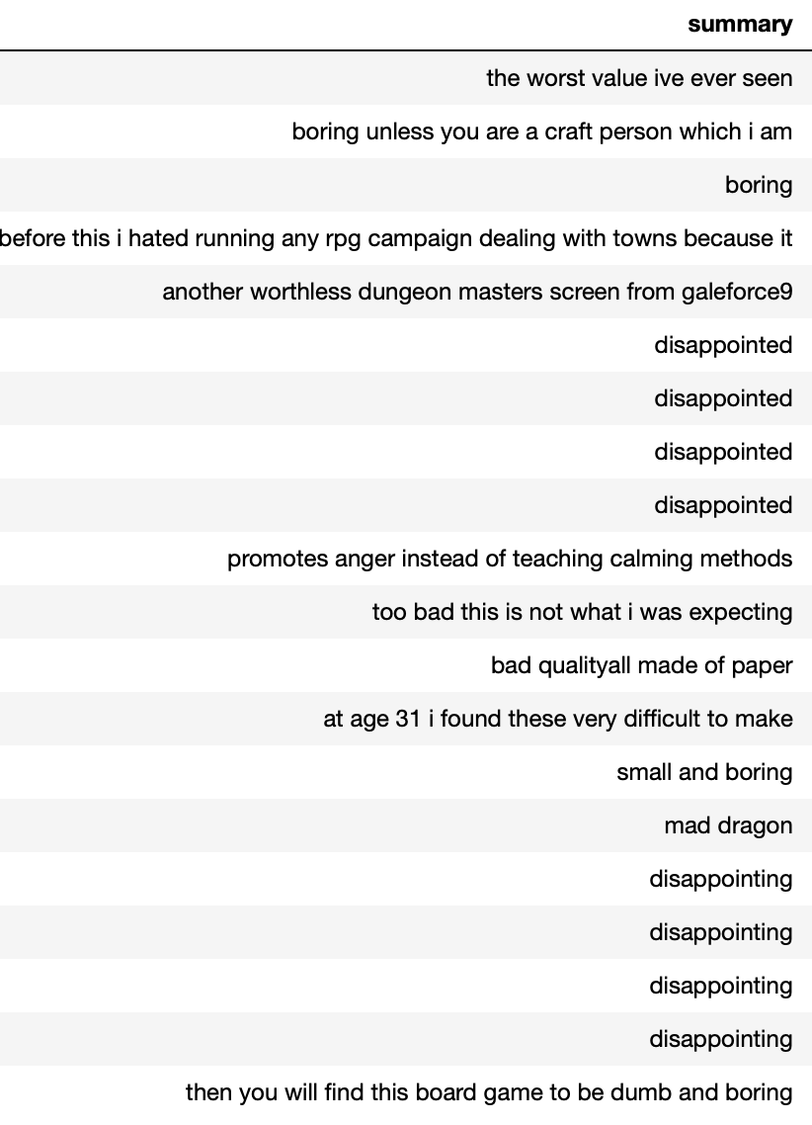
Key Facts - WHAT DO CUSTOMER THINK ABOUT OUR PRODUCTS?
Any bad comments?

Slide 10
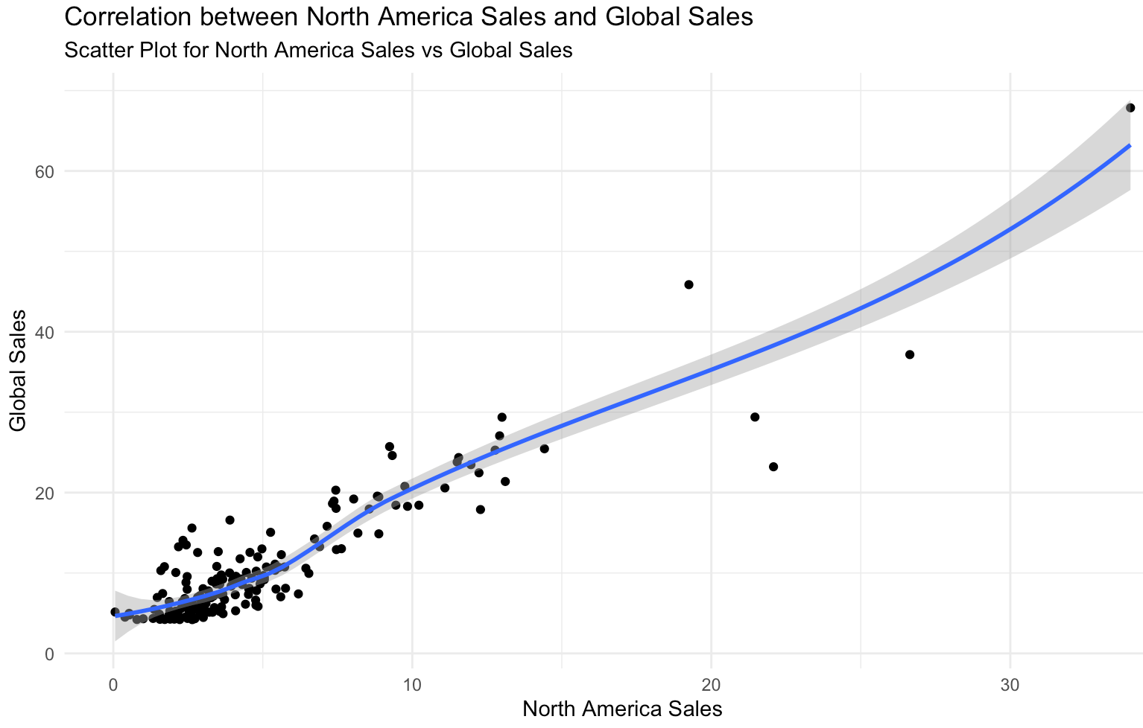
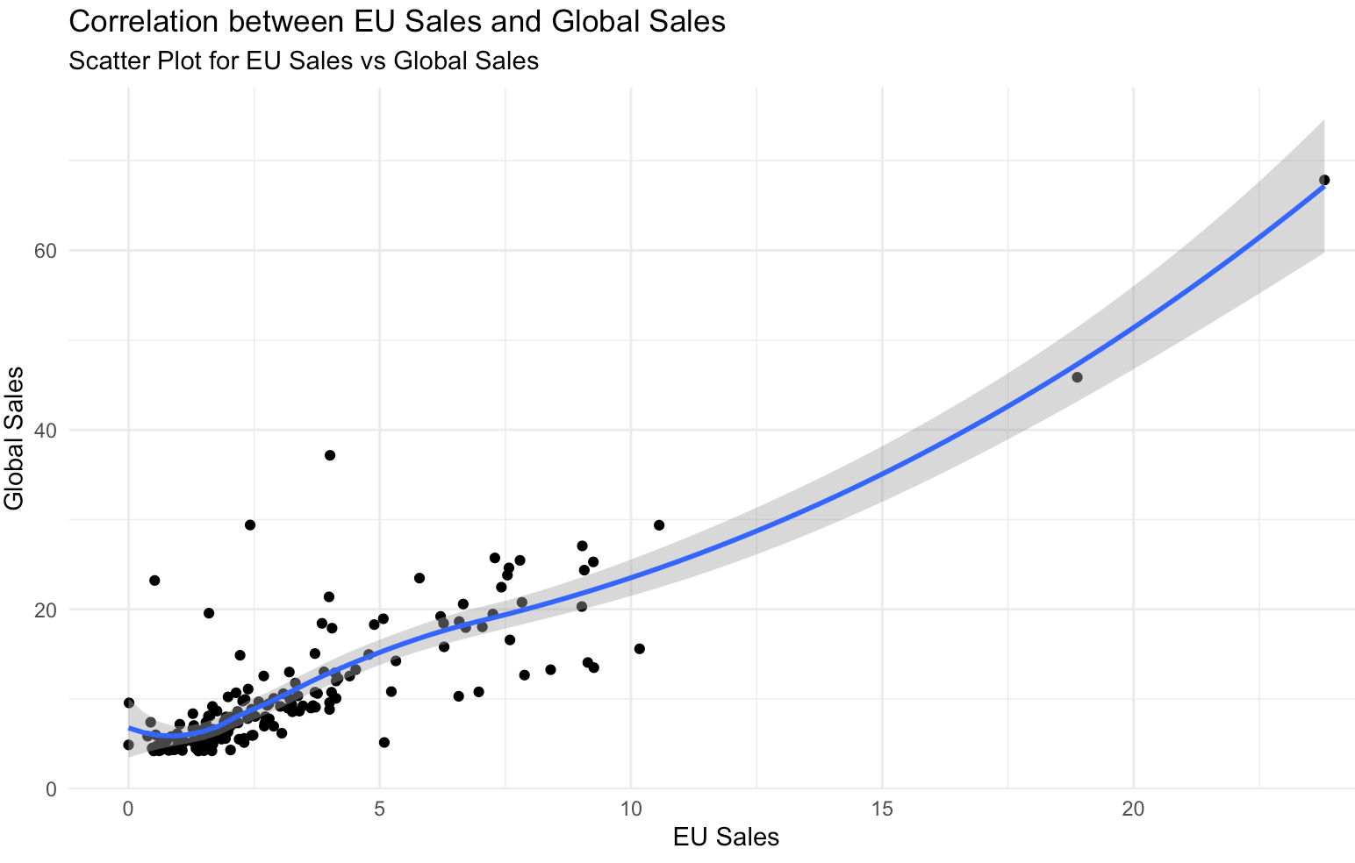
Key facts- sales analysis
North America and Europe sales are key for global success.

Slide 11
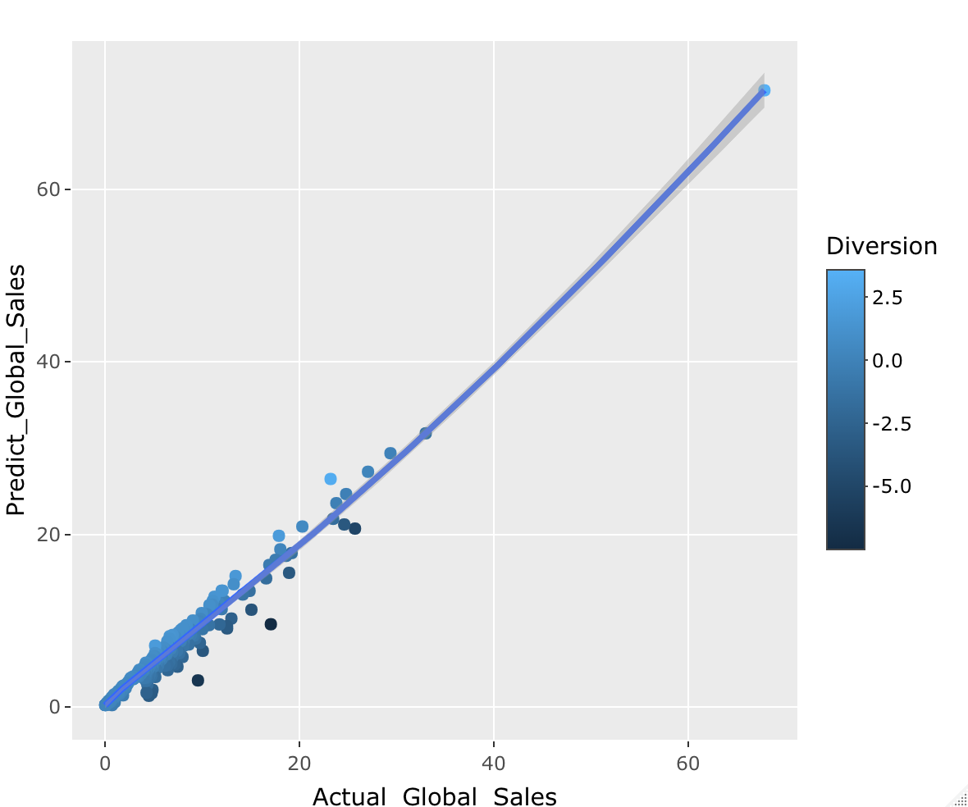
Key facts- sales analysis
Prediction of global sales is possible with Europe and North America sales input
Graph show the accuracy of prediction vs actual. We should expect straight linear diagonal line for perfect prediction.

Slide 12
FUTURE discussion points
What products are most purchased by specific customer groups?
Is there a particular product which received negative review?
Negative review comes more from certain customer group?
How does our sales evolve over the last year?

Slide 13

THANK YOU FOR LISTENING.
Q & A

